Slide 1

Leveraging Big Data for Strategic Competitiveness
Team – Binary Brains
Leelaa Akhil Sarvepalli Venkatesan
Pilli Prathimarani
Chandana Polakonda
Rajitha Sri Yarlagadda
Vaishnavi sabna

Slide 2

Introduction
In my capacity as CIO/CDO, I offer a strategy plan that advances the board's objective of integrating big data throughout the entire company.
This program's three primary themes are aggressive competition strategies, technology, and talent development.
Even with our dominant market position, we must use big data to stay competitive. It's an essential step in achieving business goals in our quick-paced industry.

Slide 3

Part-1
The implementation of big data technology is essential for commercial success in today's data-driven environment. As explained in the introduction, I offer this plan as the CIO/CDO in order to support the board's vision while pursuing a competitive advantage and meeting organizational objectives.
A user-friendly deployment model flowchart guides us in selecting the best data deployment option tailored to our company's needs.“
Before strategizing, we assess our firm's size, industry dynamics, and competition to make informed decisions.
To enhance efficiency, we propose deploying Google Cloud Platform (GCP), BigQuery, OpenRefine, Hadoop, Cloud Spanner, and Looker Studio.
Success hinges on workforce skills; we'll conduct training and recruit talent to ensure proficiency in big data technologies.

Slide 4
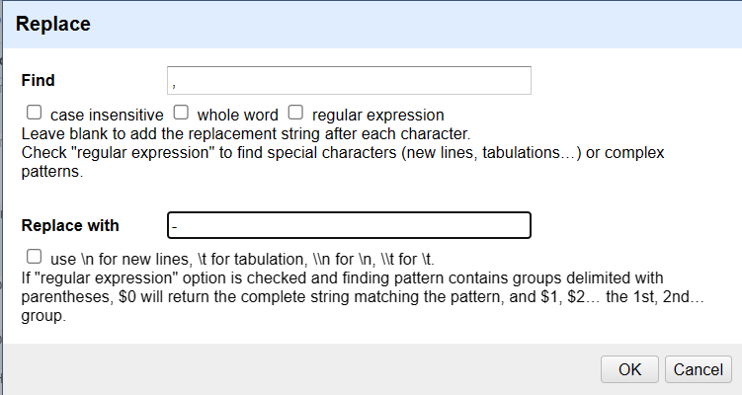
Part -2
In this step we are doing Data pre-processing.
Because of the commas in "Product Name," the sales_record_1_ADTA5240.csv dataset presents issues that require preprocessing in order to analyse it effectively.
After uploading the CSS file and creating a project. We will be editing the cells of product by choosing find and replace the commas with hifens(-).
Ensuring accuracy in processing without compromising integrity. For an improved dataset, extensive data cleaning was carried out, missing values were handled, and zip codes and states were verified.
Successfully preprocessed dataset, now ready for analysis, with improved quality and integrity, paving the way for insightful exploration.

Slide 5
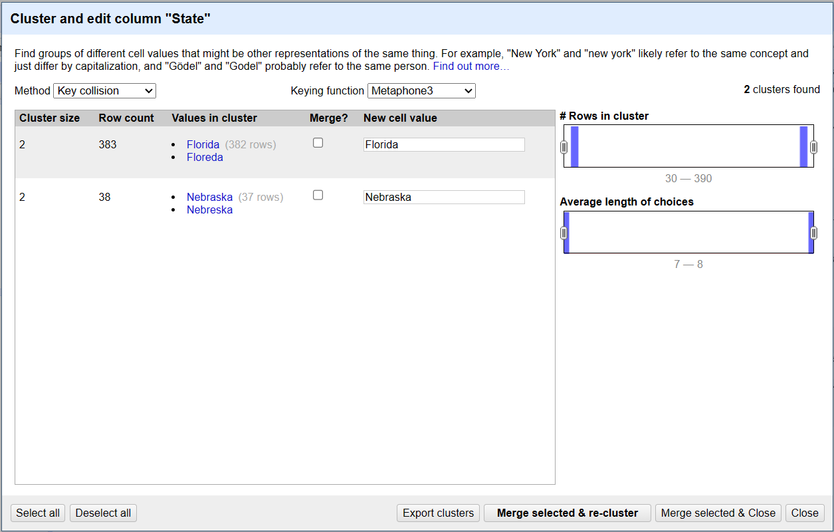
Part -3
Data Validation for State Names:
Utilized OpenRefine's text facet option to identify potential errors in the "State" column.
Employed the "Cluster" option with "Key collision" and "Methaphone3" for error detection, revealing issues with the state names "Florida" and "Nebraska.“
Manual Correction Process:
Selected "Merge?" for the respective values in the cluster and executed "Merge selected & re-cluster" for both "Florida" and "Nebraska.“
Manually edited the state name "Texs" to "Texas" in the text facet, ensuring accuracy.
Post-Validation State Check:
Revisited the text facet to re-verify and manually corrected the remaining error for the state of "Texas."
Postal Code Examination:
Employed the text facet option to inspect postal codes, identifying values less than 5 digits.
Used a custom text facet to filter and visually confirm 438 rows with 4-digit postal codes.
Correction Procedure for 4-Digit Codes:
Applied the expression "if(value.length()<5, '0'+value, value)" using Edit Cells -> Transform to prepend '0' to 4-digit codes.
Rechecked with a custom text facet, ensuring all postal codes were now 5 digits.
Error Handling for Longer Postal Codes:
Identified and manually corrected two rows with error values in the "Postal Code" column.
Dataset Export:
Exported the cleaned dataset as "Comma-separated values," saving it as "Cleaned_records_3.csv" for further analysis.

Slide 6
Part 4
The SVP of Business Strategy aims to formulate a new business strategy based on insights from the dataset, and as the Senior Assistant, I'm tasked with extracting specific information for strategic decision-making.
Data Import to GCP (Google Cloud Platform):
Imported the dataset into GCP's BigQuery by enabling the BigQuery API under the project ID: adta5240sarvepalli, and accessing BigQuery Studio in the cloud console.
Dataset Creation:
Created a dataset named "Cleaned_records" with a multi-region setup (US) through the BigQuery Studio, providing essential details and leaving advanced options as default.
Table Creation:
Uploaded the cleaned dataset "Cleaned_records_3.csv" to create a table named "Cleaned_records3," specifying the schema, including fields like Sales, Quantity, and State.
Table Preview and Querying:
Previewed the table to ensure data integrity and utilized the SQL Query editor to perform specific queries for strategic insights.
First Query - Top Five States with Most Customers:
Executed a SQL query to identify the top five states with the highest number of customers, providing valuable insights into customer distribution across regions.
Second Query - Top Ten Zip-Codes by Sales Amount:
Created a new SQL query to determine the top ten zip-code areas where the company achieves the highest sale amounts, crucial for understanding revenue hotspots.

Slide 7

Conclusion
Our project, which focused on data pretreatment procedures, verification, and intelligent BigQuery querying, effectively showcased the application of big data technologies. Our strategy was informed by factors such as business size, industry, and competitiveness; GCP BigQuery and OpenRefine were important pillars of the plan.
A high-quality and consistent dataset was guaranteed by the thorough data preprocessing, which fixed mistakes like commas in the "Product Name" and confirmed the "State Names" and "Postal Codes." Strategic decision-making requires access to valuable insights from BigQuery findings, including the top states and postal codes with significant consumer interaction and sales.
In today's changing business environment, this initiative emphasises how important it is to use big data technology to obtain a competitive edge and accomplish organisational goals."

Slide 8

Thank You

